Slide 1

COMMUNITY DETECTION WITH MULTI-LAYERED GRAPHS USING SOCIAL NETWORK ANALYSIS
Presented By- Group 22
Dibya Kundu(13000119063)
Sayanta Kundu(13000119095)
Abhirup Ghosh(13000119097)
Anushka Das(13001619098)

Slide 2
Problem Statement
Group 22- COMMUNITY DETECTION WITH MULTI-LAYERED GRAPHS USING SOCIAL NETWORK ANALYSIS
In movies certain character interacts with certain characters a bit more than the rest of all characters
In Social Media one user interacts with a certain section of accounts more than the others.
Our goal is to differentiate the set of characters which are more interactive in between them

Slide 3
Approach taken
Group 22- COMMUNITY DETECTION WITH MULTI-LAYERED GRAPHS USING SOCIAL NETWORK ANALYSIS
Treat the characters/accounts as nodes of a graph
Interaction between the characters as an edge. Value of Interaction as edge weight
Differentiate the nodes in different communities with respect to certain metrics. Use metrics dependent on number of edges, edge weights

Slide 4
Problem Domain
Group 22- COMMUNITY DETECTION WITH MULTI-LAYERED GRAPHS USING SOCIAL NETWORK ANALYSIS
Project is mainly based on Social Network Analysis
Detecting Communities in a network to group different users in different clusters.

Slide 5
Why?
Group 22- COMMUNITY DETECTION WITH MULTI-LAYERED GRAPHS USING SOCIAL NETWORK ANALYSIS
To find how users interact with each other in different social networking sites.
To study the internal organization of the clusters.
To study how one node interact with another node in its own cluster and interact with a node present in a different cluster.

Slide 6
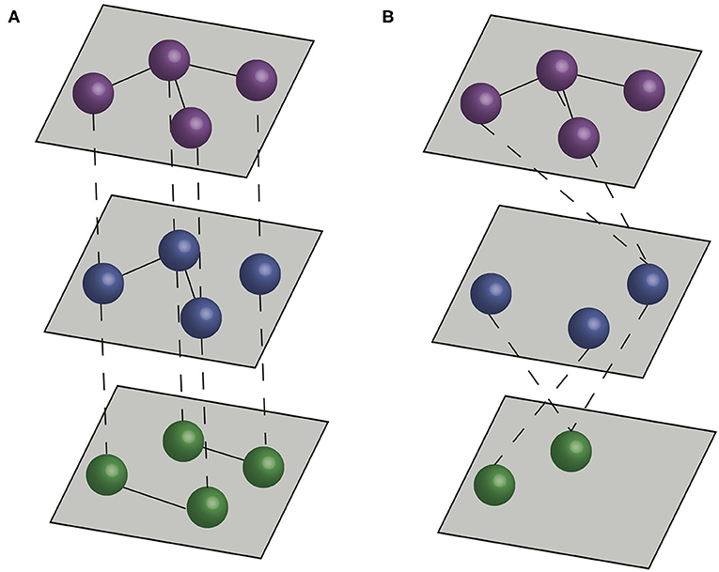
What is Multi-Layered network?
Group 22- COMMUNITY DETECTION WITH MULTI-LAYERED GRAPHS USING SOCIAL NETWORK ANALYSIS
A network made up of multiple layers.
Each layer have multiple nodes that interact with each other.
Nodes from different layer interact with each other.

Slide 7
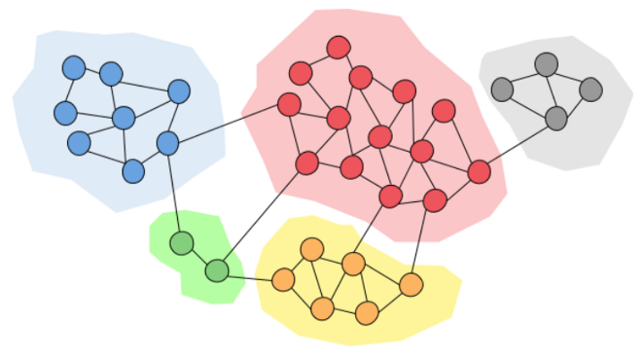
Communities in a network
Group 22- COMMUNITY DETECTION WITH MULTI-LAYERED GRAPHS USING SOCIAL NETWORK ANALYSIS
Subsections of a network.
The nodes in one community are densely connected with each other.
The nodes in different community are sparsely connected with each other.
Each community can be called a layer in the network

Slide 8
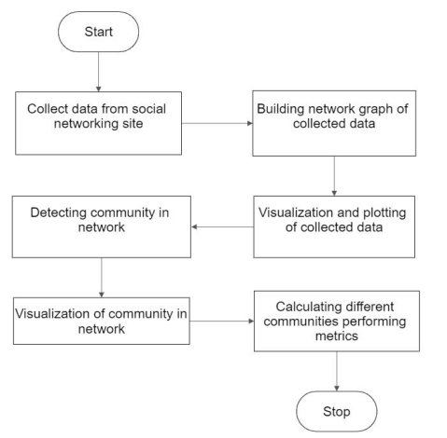
Flowchart
Group 22- COMMUNITY DETECTION WITH MULTI-LAYERED GRAPHS USING SOCIAL NETWORK ANALYSIS

Slide 9
Visualization of Datasets
Group 22- COMMUNITY DETECTION WITH MULTI-LAYERED GRAPHS USING SOCIAL NETWORK ANALYSIS
2d and 3d plots for different network data
Networkx used to create the network
Matplotlib for 2d plotting
Plotly for 3d Plotting

Slide 10
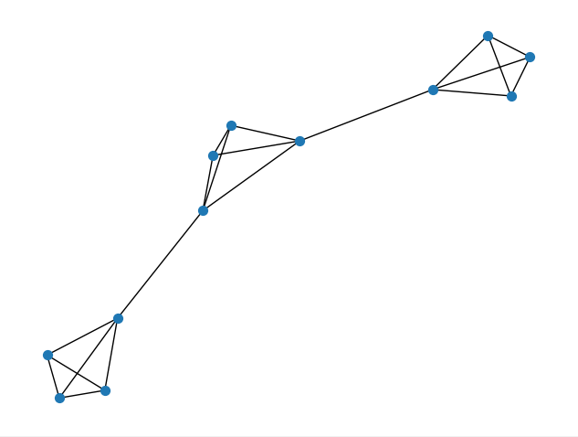
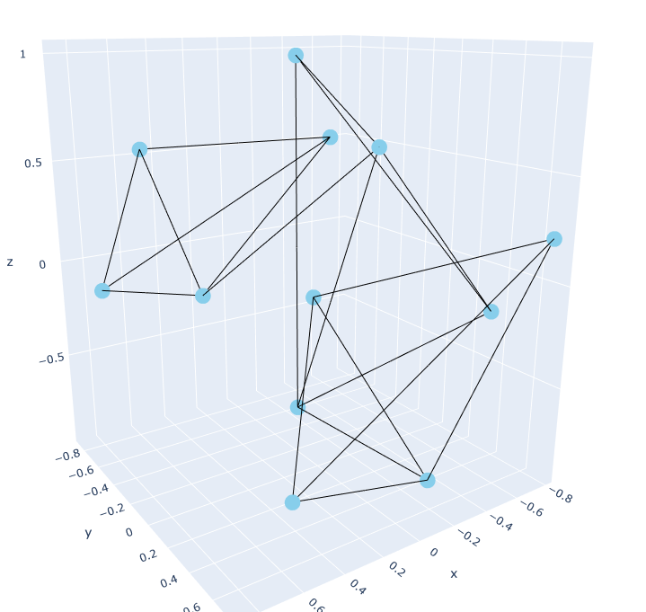
Visualization of Data- Example 1
Group 22- COMMUNITY DETECTION WITH MULTI-LAYERED GRAPHS USING SOCIAL NETWORK ANALYSIS
Edgelist:
[(1,2),(1,3),(1,4),(2,3),(2,4),(3,4),(5,6),(5,7),(5,8),(6,7),(6,8),(7,8),(4,5),(9,10),(9,11),(9,12),(10,11),(10,12),(11,12),(8,9)]

Slide 11
Community Detection Algorithms
Group 22- COMMUNITY DETECTION WITH MULTI-LAYERED GRAPHS USING SOCIAL NETWORK ANALYSIS
Algorithms that divide networks into different communities with respect to different metrics.
Girvan-Newman Algorithm: Detect communities using edge betweenness centrality
Modularity Maximization Algorithm

Slide 12
Girvan-Newman Algorithm
Group 22- COMMUNITY DETECTION WITH MULTI-LAYERED GRAPHS USING SOCIAL NETWORK ANALYSIS
Detects Communities based on edge betweenness centrality.
Betweenness Centrality is a measure to count the number of shortest paths passing through a vertex.
The algorithm is divided in 4 different steps:
For every edge in a graph, calculate the edge betweenness centrality.
Remove the edge with the highest betweenness centrality.
Calculate the betweenness centrality for every remaining edge.
Repeat steps 2-4 until there are no more edges left.

Slide 13
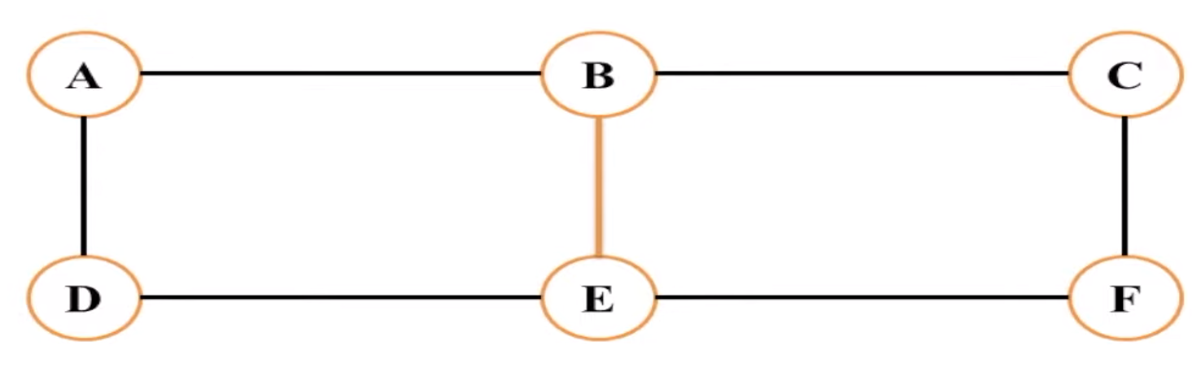
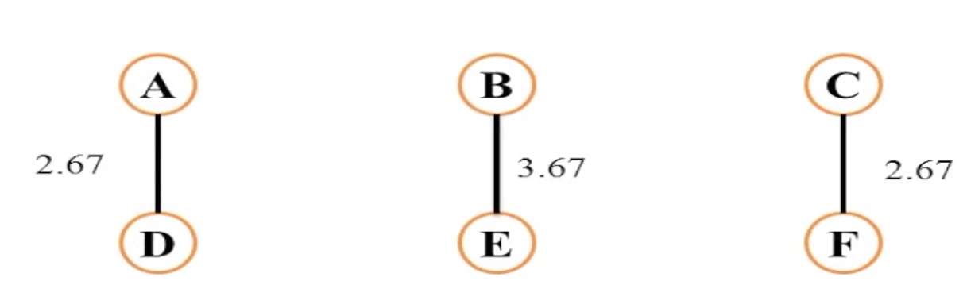
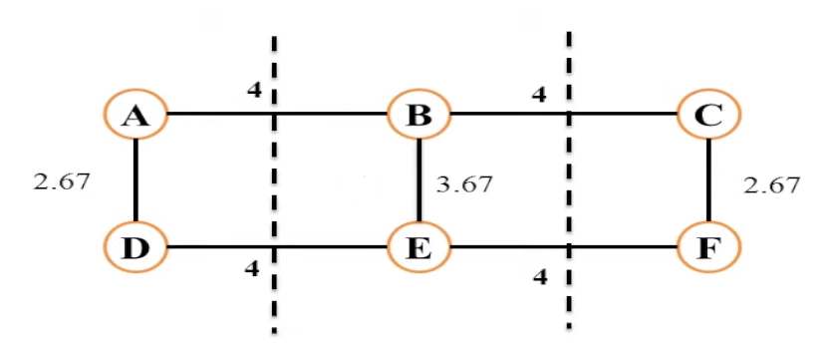
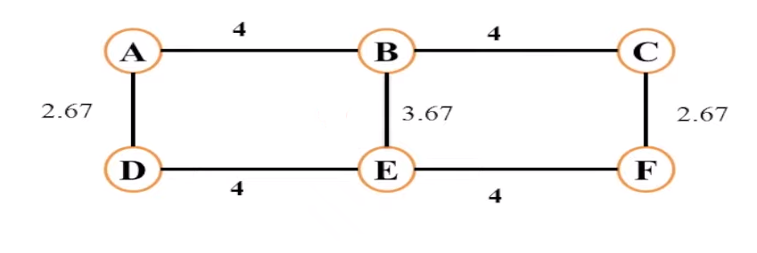
Girvan-Newman Algorithm (Cont.)
Group 22- COMMUNITY DETECTION WITH MULTI-LAYERED GRAPHS USING SOCIAL NETWORK ANALYSIS

Slide 14
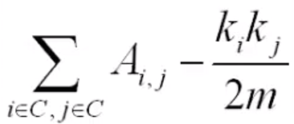
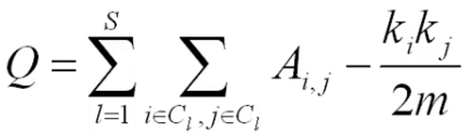
Modularity Maximization (For Unweighted networks)
Group 22- COMMUNITY DETECTION WITH MULTI-LAYERED GRAPHS USING SOCIAL NETWORK ANALYSIS
Modularity is a measure of the structure of networks or graphs which measures the strength of division of a network into modules by considering the degree distribution
Strength of a community C:
For a network with S communities and a total number of s edges, the modularity will be:
m is the total number of edges present in the graph, k_{i} is the degree of the node i, A_{i,j} is 1 if there is an edge between i and j else 0.

Slide 15
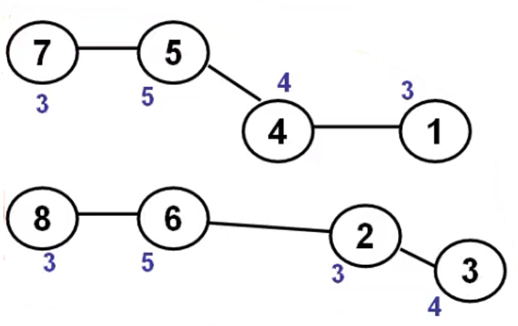
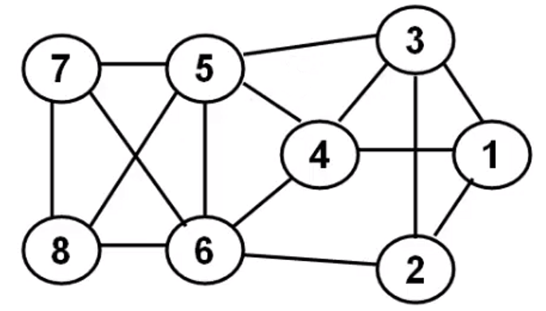
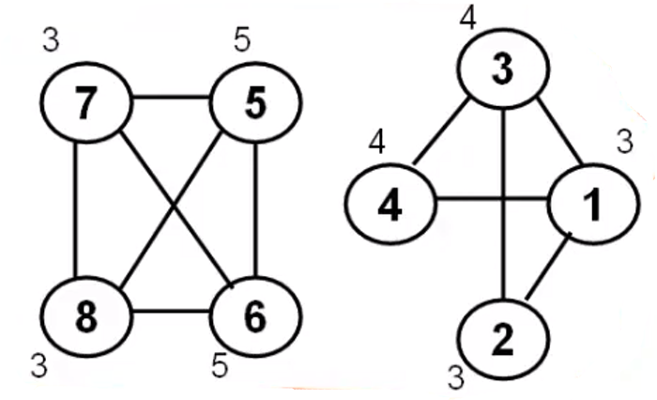
Modularity Maximization(cont.)
Group 22- COMMUNITY DETECTION WITH MULTI-LAYERED GRAPHS USING SOCIAL NETWORK ANALYSIS

Slide 16
Modularity Maximization(cont.)
Group 22- COMMUNITY DETECTION WITH MULTI-LAYERED GRAPHS USING SOCIAL NETWORK ANALYSIS
Modularity for community 1 [1,4,5,7]
= m(1,4) + m(4,5) + m(5,7) + m(1,5)+m(1,7)+m(4,7)
= 0.6+0.33+0.5-0.5-0.3-0.4
= 0.23
Modularity for community 2[2,3,6,8]
= 0.6+0.5+0.5-0.3-0.67-0.4
=0.23
Total modularity for network with the 2 communities are = 0.46

Slide 17
Modularity Maximization
Group 22- COMMUNITY DETECTION WITH MULTI-LAYERED GRAPHS USING SOCIAL NETWORK ANALYSIS
Modularity for community 1 [1,2,3,4]
=m(1,2)+m(1,3)+m(1,4)+m(2,3)
+m(3,4)+m(2,4)
=0.7+0.6+0.6+0.7+0.47-0.4
=2.67
Modularity for community 2[5,6,7,8]
= 2.87
Total modularity of the network = 5.54
We can come to conclusion that this division is more effective than the previous one.

Slide 18
Modularity Maximization(Cont.)
Group 22- COMMUNITY DETECTION WITH MULTI-LAYERED GRAPHS USING SOCIAL NETWORK ANALYSIS
Algorithm:
Step 1: Assign each node to a community Of its own. Hence we Start with N communities
Step 2: Inspect each pair Of communities connected by at least one link and compute the modularity variation obtained if we merge these two communities.
Step 3: Identify the community pairs for which ΔM is the largest and merge them. Note that modularity of a particular partition is always calculated from the full topology of the network.
Step 4: Repeat step 2 until all nodes are merged into a single community,
Step 5: Record for each step and select the partition for which the modularity is maximal.

Slide 19
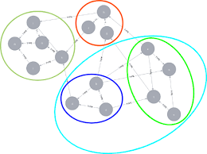
Louvain Algorithm for weighted graphs
The Louvain algorithm is used for community detection in weighted graphs.
It starts by assigning each node to its own community.
The algorithm iteratively merges communities to maximize the modularity of the graph.
The modularity gain of moving a node to a community is calculated based on the difference in modularity before and after the move.
The modularity of a graph measures the quality of the community structure.

Slide 20
Louvain Algorithm for weighted graphs(Cont.)
The algorithm terminates when no more communities can be merged without decreasing the modularity.
The final communities identified by the algorithm are the output.
The Louvain algorithm is efficient and capable of handling large graphs with millions of nodes and edges.
It is a heuristic algorithm, so it may not always find the optimal solution.

Slide 21
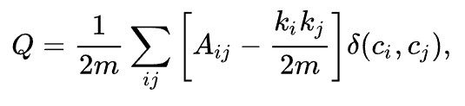
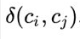
Louvain Algorithm for weighted graphs(Cont.)
For a weighted graph, modularity is defined as:
A_{i,j} represents the edge weight between nodes i and j.
k_{i} and k_{j} are the sum of the weights of the edges attached to nodes i and j, respectively
m is the sum of all of the edge weights in the graph
c_{i} and c_{j} are the communities of the nodes
6efeefe is Kronecker delta function

Slide 22
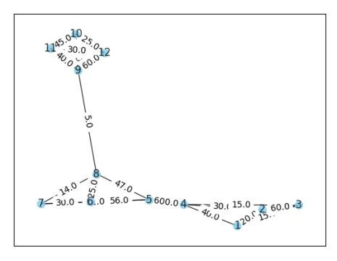
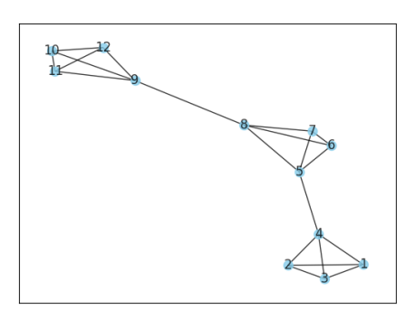
Louvain Algorithm for weighted graphs(Cont.)

Slide 23
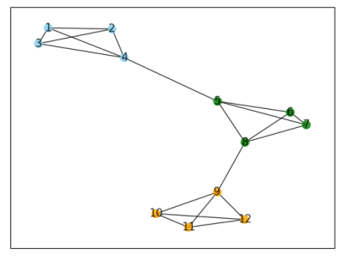
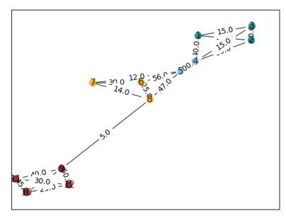
Louvain Algorithm for weighted graphs(Cont.)
Communities :
(1,2,3,4), (5,6,7,8), (9,10,11,12)
Communities :
(1,2,3), (4,5), (6,7,8), (9,10,11,12)

Slide 24
Dataset Preparation
We've prepared a csv file for the interactions from the movie "Harry Potter and the Philosopher's Stone"
The movie has 42 main characters interacting with each other.
The network has 42 nodes for each character and 118 edge for the cumulative interactions in between the characters.

Slide 25
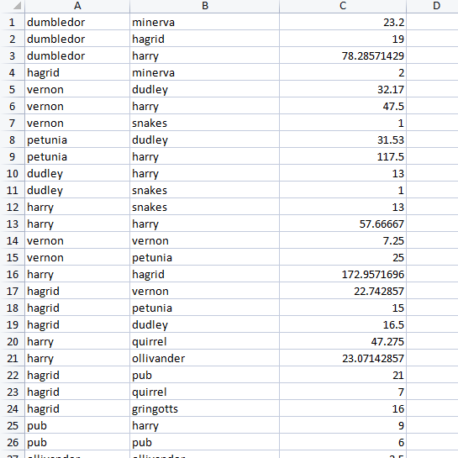
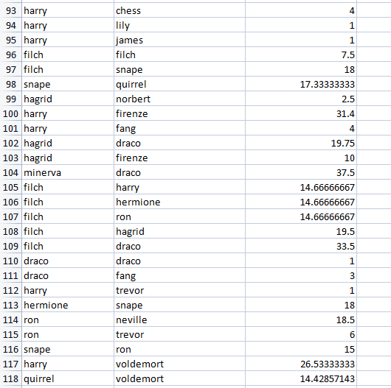
Dataset Preparation – Total interactions in movie

Slide 26
Test Results
Created Communities-
Community 1
dumbledor, percy, spells, students, nearly_headless_nick, portraits, seamus, hooch, dean, ghosts, flitwick, commentator
Community 2
minerva, ron, hermione, neville, trevor, chess
Community 3
draco, filch, fang
Community 4
hagrid, harry, vernon, dudley, snakes, petunia, quirrel, ollivander, pub, gringotts, sorting_hat, snape, wood, lily, james, norbert, firenze, voldemort
Community 5
mrs_weasley,ginny, fred_george

Slide 27
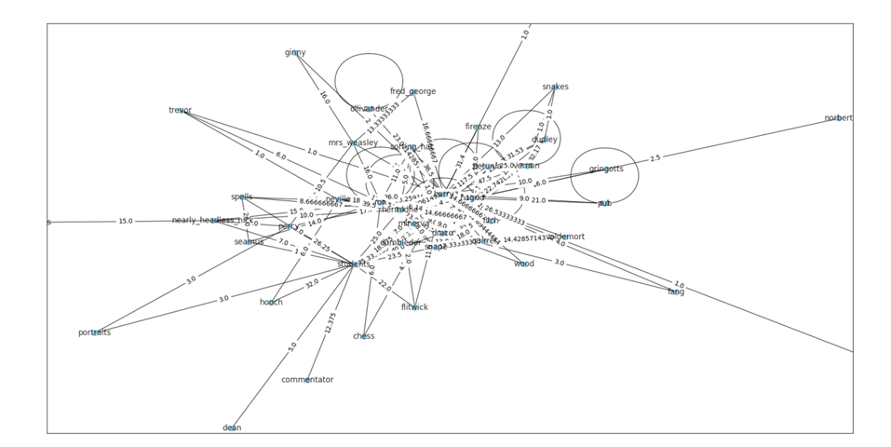
Test Results and Analysis
Graph structure from the movie before detecting communities

Slide 28
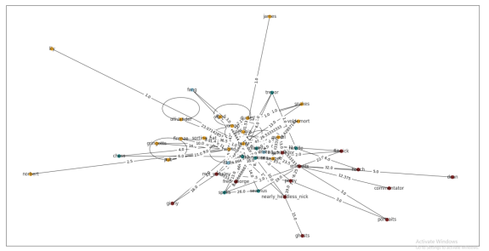
Test Results and Analysis
Graph structure from the movie after detecting communities

Slide 29
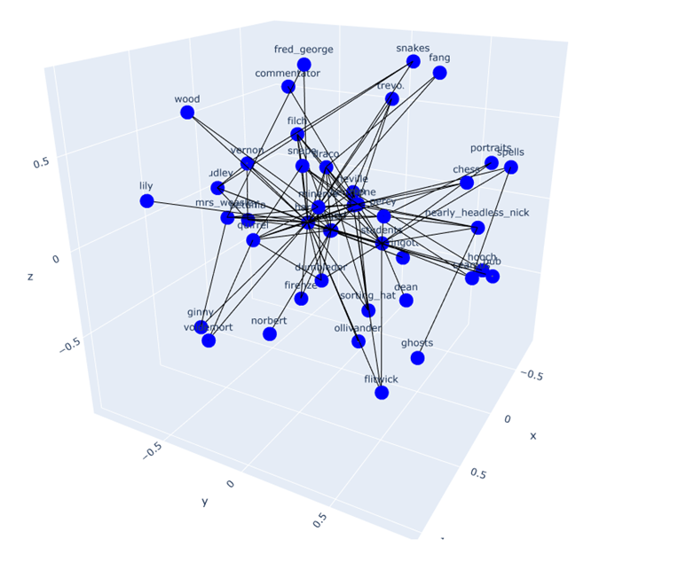
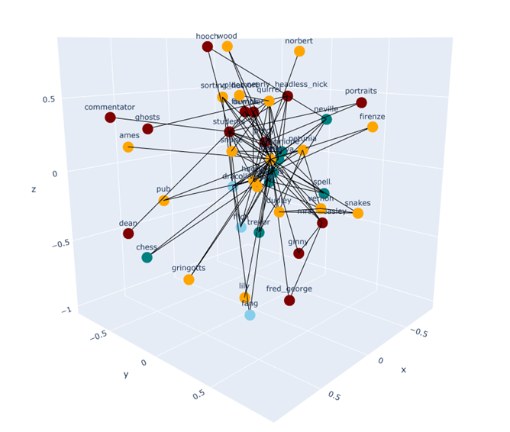
Test Results and Analysis
Plain graph structure
Graph with detected communities

Slide 30
Pearson Correlation Coefficient
Measure of the linear relationship between two variables to quantify the strength and direction of the relationship between two continuous variables
For multilayer graphs it measures the similarity between the patterns of edges across different layers

Slide 31
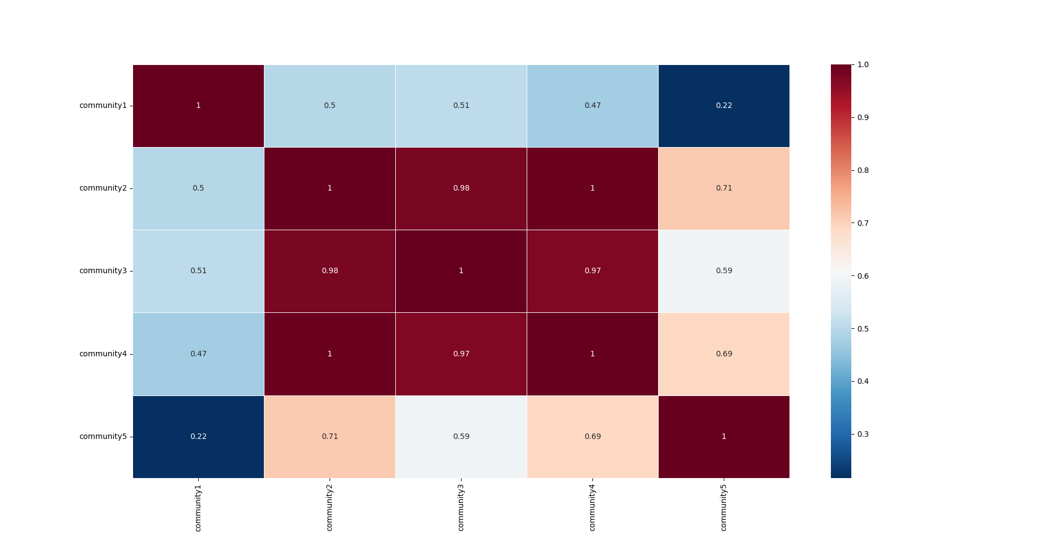
Pearson Correlation Coefficient for the created communities

Slide 32
Project benefits
Group 22- COMMUNITY DETECTION WITH MULTI-LAYERED GRAPHS USING SOCIAL NETWORK ANALYSIS
Relationships between entities in datasets are often of multiple types, which can naturally be modeled by a multi-layer graph.
Application to Real-Life Networks with Huge Data
Generalizability and Transferability

Slide 33
Hardware and Software requirements
Group 22- COMMUNITY DETECTION WITH MULTI-LAYERED GRAPHS USING SOCIAL NETWORK ANALYSIS
Hardware requirements:
Microsoft Windows 8/10(64 bit)
4 GB RAM minimum,8 GB RAM recommended
Software Requirements:
OS – Windows 10/ Ubuntu 18.04
Programming Language: Python 3
Tools: Jupyter Notebook/PyCharm Notebook/Google Colab/Notepad++
Dataset: Microsoft Excel(.csv file)

Slide 34
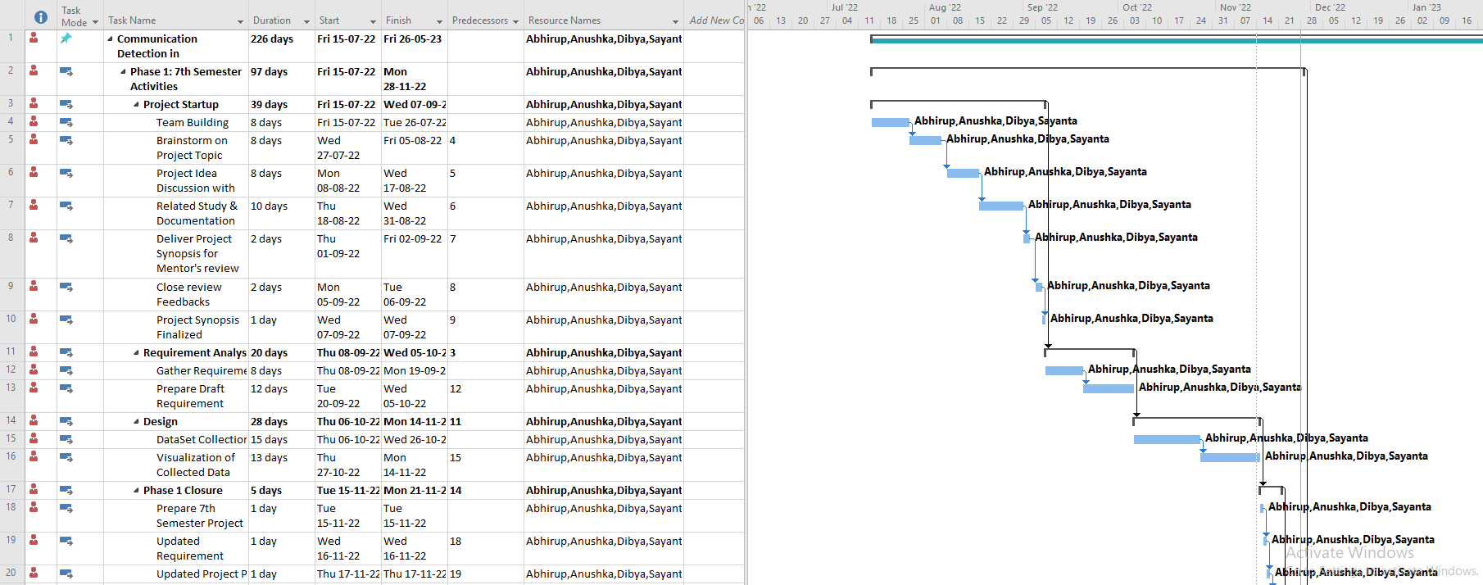
Project Plan
Group 22- COMMUNITY DETECTION WITH MULTI-LAYERED GRAPHS USING SOCIAL NETWORK ANALYSIS

Slide 35
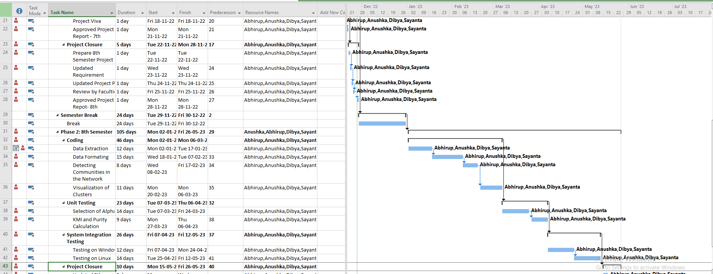
Project Plan(cont.)
Group 22- COMMUNITY DETECTION WITH MULTI-LAYERED GRAPHS USING SOCIAL NETWORK ANALYSIS

Slide 36
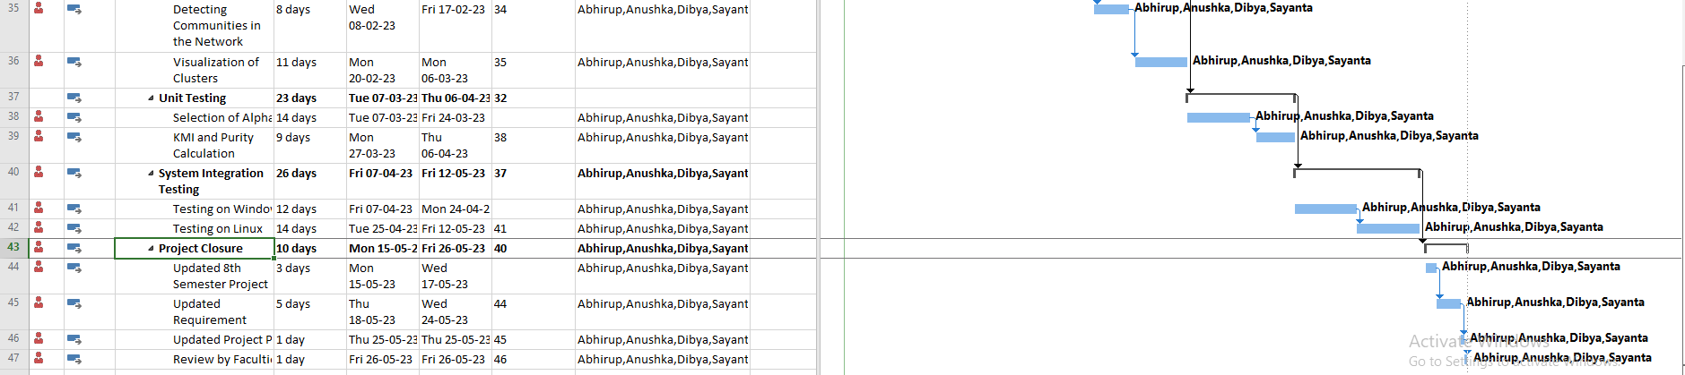
Project Plan(cont.)
Group 22- COMMUNITY DETECTION WITH MULTI-LAYERED GRAPHS USING SOCIAL NETWORK ANALYSIS

Slide 37
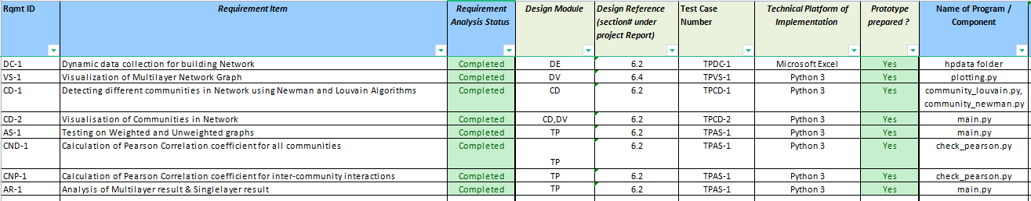
Requirement Matrix
Group 22- COMMUNITY DETECTION WITH MULTI-LAYERED GRAPHS USING SOCIAL NETWORK ANALYSIS

Slide 38
Future scope of improvements
Group 22- COMMUNITY DETECTION WITH MULTI-LAYERED GRAPHS USING SOCIAL NETWORK ANALYSIS
The scope includes exploring and implementing various community detection strategies such as cluster expansion, matrix factorization, unified distance, model-based approaches, and pattern mining
Performing community detection on underlying strategies like cluster expansion, matrix factorization, unified distance, model-based, pattern mining and their comparison
Entity often engages in multiple relations. Hence, the more qualified communities in multi-layer graphs can be discovered for exploiting and fusing all these different aspects of information

Slide 39
Conclusion
Group 22- COMMUNITY DETECTION WITH MULTI-LAYERED GRAPHS USING SOCIAL NETWORK ANALYSIS
The system we are trying to build will provide a framework which will analyze information in multi-layered networks and detect communities of graphs with rich datasets.
We can compare the created clusters using different performance metrics.
The use of multi-layer graphs enables the identification and analysis of inter-layer clusters, which are communities that span across different relationship types or aspects of the entities

Slide 40
References
Group 22- COMMUNITY DETECTION WITH MULTI-LAYERED GRAPHS USING SOCIAL NETWORK ANALYSIS
Meena, Pawan, Mahesh Pawar, and Anjana Pandey. "A Survey on Community Detection Algorithm and Its Applications." Turkish Journal of Computer and Mathematics Education (TURCOMAT) 12.6 (2021): 4807-4815.
● Huang, Xinyu, et al. "A survey of community detection methods in multilayer networks." Data Mining and Knowledge Discovery 35.1 (2021): 1-45.
Kim, Jungeun, and Jae-Gil Lee. "Community detection in multi-layer graphs: A survey." ACM SIGMOD Record 44.3 (2015): 37-48.
T. Aynaud. python-louvain x.y: Louvain algorithm for community detection. 2020. https://github.com/taynaud/python-louvain
Annamaria Ficara & Giacomo Fiumara & Salvatore Catanese & Pasquale De Meo & Xiaoyang Liu, 2022."The Whole Is Greater than the Sum of the Parts: A Multilayer Approach on Criminal Networks," Future Internet, MDPI, vol. 14(5), pages 1-21, April.
M. Chen, K. Kuzmin and B. K. Szymanski, "Community Detection via Maximization of Modularity and Its Variants," in IEEE Transactions on Computational Social Systems, vol. 1, no. 1, pp. 46-65, March 2014, doi: 10.1109/TCSS.2014.2307458

Slide 41


